Slide 1

NYC Airbnb Analysis: EDA + Price Prediction
GROUP 15:
Satyaraj Reddy Nandi (snandi1@student.gsu.edu)
Aashrith Sangani (asangani1@student.gsu.edu)
Neha Pinjala (npinjala1@student.gsu.edu)

Slide 2
Problem Statement
The main influence for this project came in as we often find ourselves immersed in the how a giant like Airbnb predicts the prices for their hosts:
What can we learn about different hosts and areas?
What can we learn from the predictions? (ex: locations, prices, reviews, etc.)
Which hosts are the busiest and why?
Is there any noticeable difference of traffic among different areas and what could be the reason for it?
This project aims to solve the problems using ML techniques to predict the prices for listings in the NYC area along with performing EDA in the due course.

Slide 3
Data Source(s)
The dataset has been sourced from kaggle.com, from which any personal identifying data such as name,host_name have been removed.
This public dataset is part of Airbnb, and the original source can be found on this website This dataset describes the listing activity and metrics in NYC, NY for 2019. This data file includes all needed information to find out more about hosts, geographical availability, necessary metrics to make predictions and draw conclusions.
Link to the dataset: http://insideairbnb.com

Slide 4
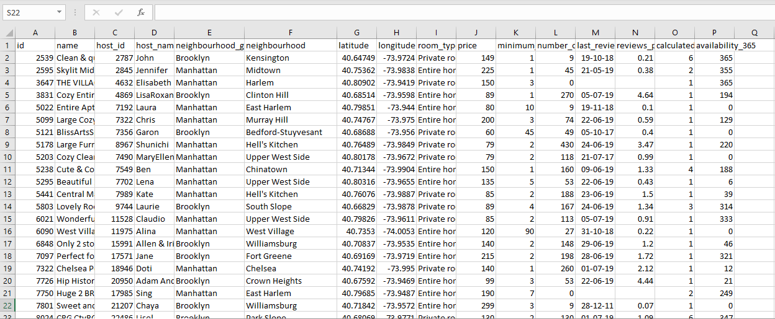
A snippet of how the data looks like:
The dataset has been sourced from kaggle.com, from which any personal identifying data such as name,host_name have been removed.
This public dataset is part of Airbnb, and the original source can be found on this website This dataset describes the listing activity and metrics in NYC, NY for 2019. This data file includes all needed information to find out more about hosts, geographical availability, necessary metrics to make predictions and draw conclusions.
Link to the dataset: http://insideairbnb.com

Slide 5
Data Source(s)
Contains pricing information[including categorical variables] such as:
Host_ID
Neighborhood group along with the neighborhood name
Latitude & longitude of the places
Room type listed by the host
The number of reviews along with reviews_per_month
Availability of the place in a cycle of 365 days
Prices of the individual listings

Slide 6
Data Source(s)
We’ll be using the dataset to model and predict the below:
Performing EDA on the dataset [Data Cleaning, Data Visualization & Word Cloud]
Predict the price of the listings by employing Random Forest Regression & XG Boost algorithms after proper data cleaning, label encoding, normalization & feature engg.
Platform used: Jupyter Notebook

Slide 7
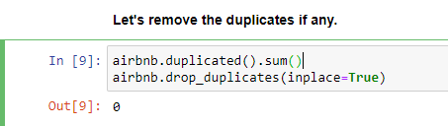
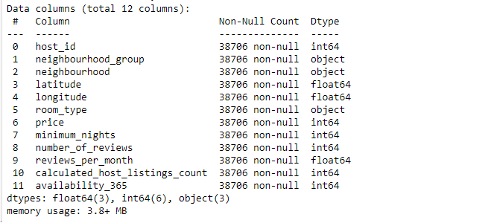
Data Preparation
Data Cleaning
Dropping duplicates values(if any) in the dataset: duplicated() & drop_duplicates
Removing the NaN values from the dataset: isnull().sum() & dropna()
Filling NaN values in the dataset with appropriate values: fillna()
The NaN values in the respective column, reviews_per_month were replaced by 0 as it was logical to do so.
Dropping unnecessary data : drop()
Accordingly dropped certain columns from the dataframe as they were irrelevant for the models & included personal data of the hosts as well.

Slide 8
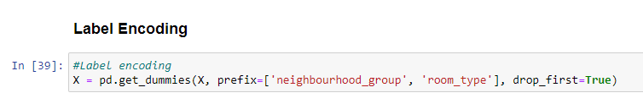
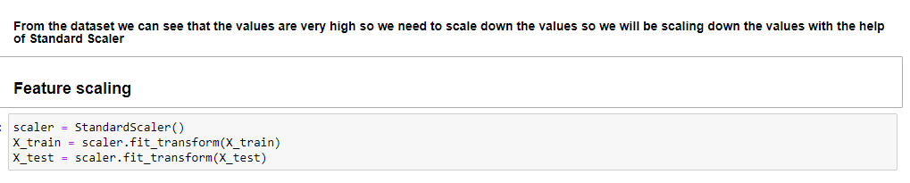
Data Preparation
Data Preprocessing
Label Encoder: LabelEncoder()
We encoded the categorical variables required to execute the correlation b/w the features.
Scaling: StandardScaler()
Scaling was also performed on the data before building the model as the values for a few features were exorbitantly high.

Slide 9
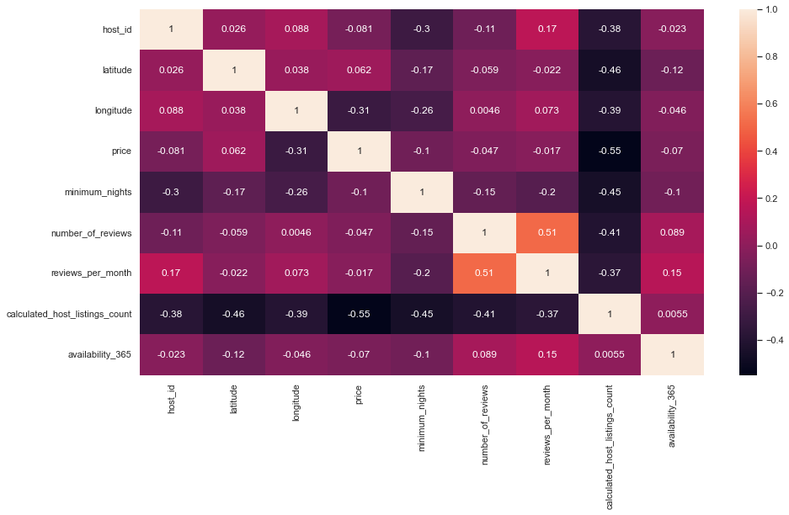
Data Preparation
Data Visualization:
CORRELATION BETWEEN
THE VARIABLES:

Slide 10
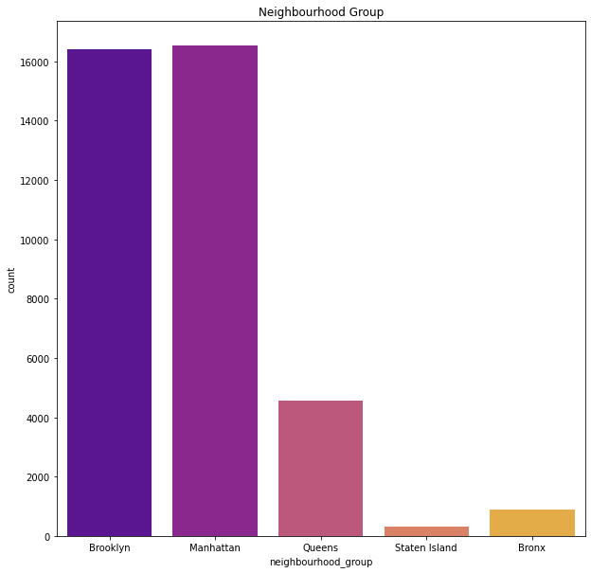
Let’s see the spread of the popularity of the neighborhood groups:
.

Slide 11
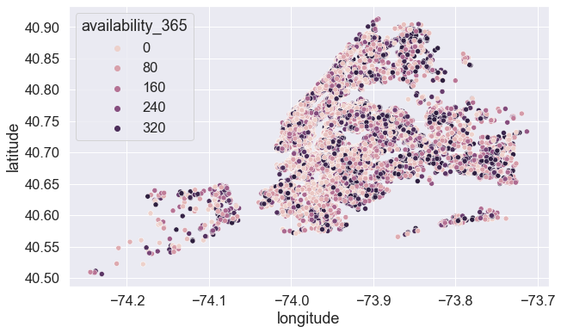
Let’s use the scatterplot to depict the availability of the rooms:

Slide 12
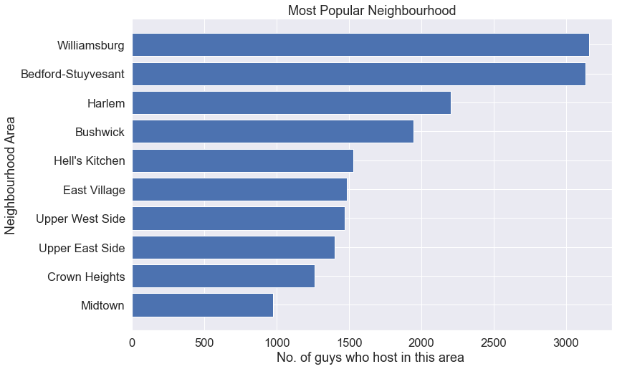
Let's plot the most popular neighborhood area in terms of the Airbnb hostings there:

Slide 13
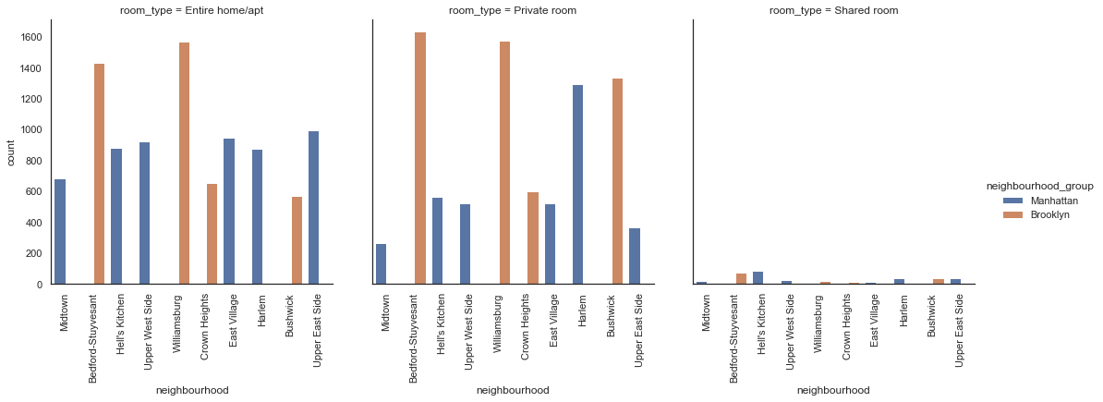
Let’s use a catplot to depict the spread of room_types among different neighbourhoods split by the neighbourhood groups:

Slide 14
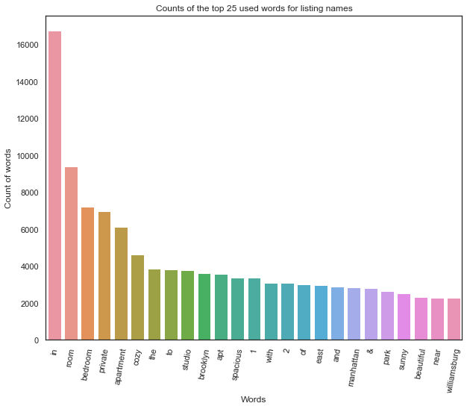
Let’s see how the words play a role in listing the houses on Airbnb:

Slide 15
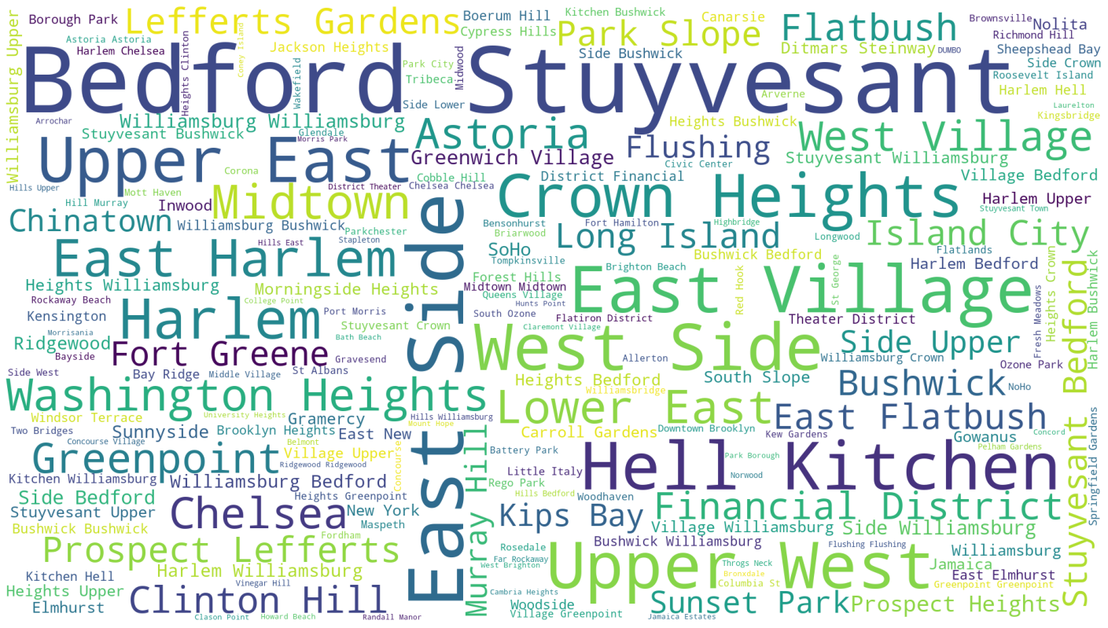
A word-cloud analysis on the neighborhood feature:

Slide 16
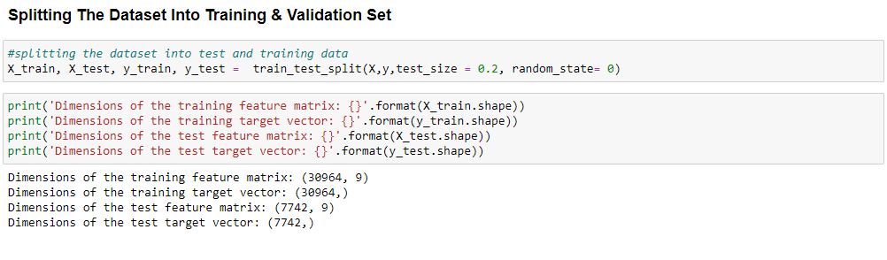
Data Preparation
Data Partition
For the modeling, we split the dataset into train and test using train_test_split().

Slide 17
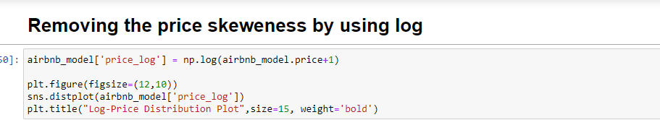
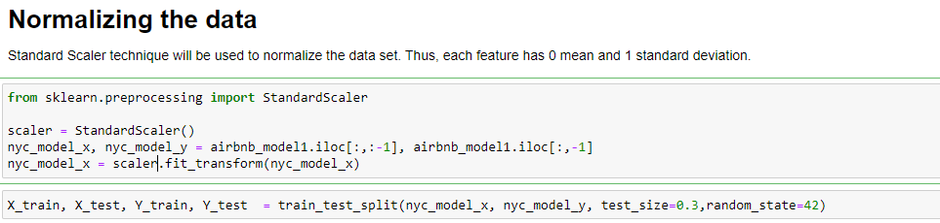
Before we started modelling, we performed label encoding along with feature processing on the data in order to make it ready for modelling: Removing the price skewness.
Normalizing the data using Standard Scaler Technique

Slide 18
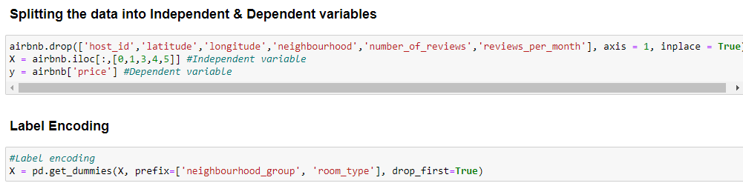
Splitting the data into different variable types along with label encoding:
We have split the data into 80 : 20.

Slide 19
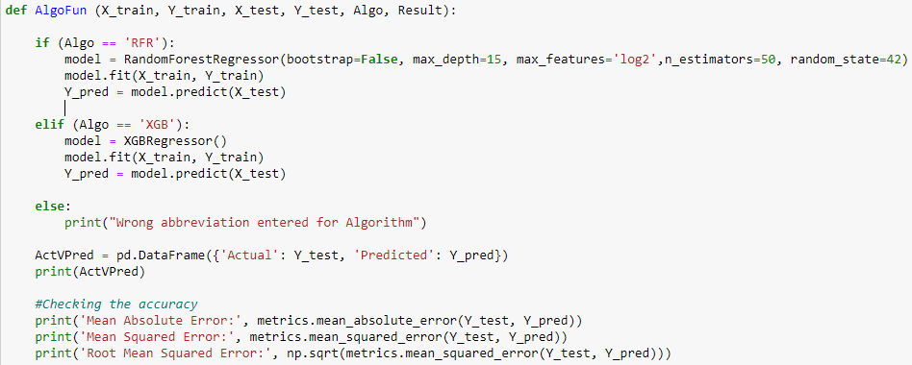
A custom function for printing out the MAE, MSE & R2E for the following models:
Code Snippet for the function:

Slide 20
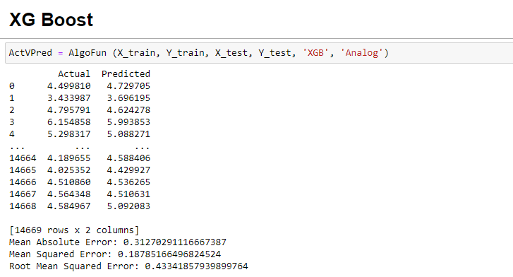
XG Boost
Code Snippet for the XG Boost model depicting the MAE, MSE & R2E values:

Slide 21
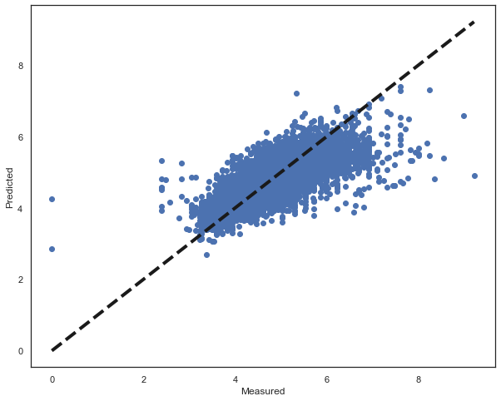
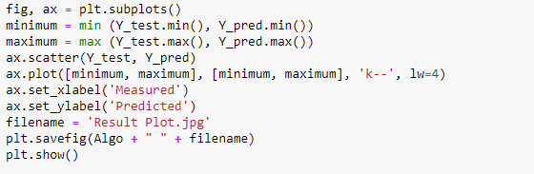
XG Boost
Plot displaying the spread of the measured and predicted values.

Slide 22
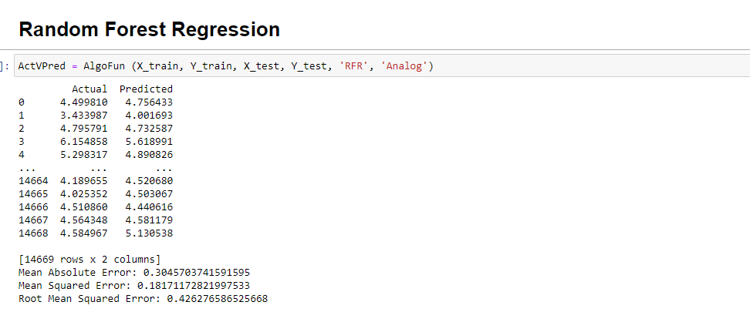
Random Forest Regression
Code Snippet for the Random Forest Regression model depicting the MAE, MSE & R2E values:

Slide 23

Random Forest Regression
Plot displaying the spread of the measured and predicted values.

Slide 24
Evaluation
•The code for the project runs from understanding how the data is given.
•Next phase is data cleaning: which involves checking for NaN values, dropping unnecessary data, removing the NaN values from the dataset: isnull().sum() & dropna(), filling NaN values in the dataset with appropriate values: fillna()
•After proper data cleaning, it’s time for data preparation which mostly involves Data Processing, as explained in the preceding pages of the document.
•Now, it’s time to visualize the data. We published major findings on how the dataset gave us immense results. It helped us understanding the demographics of the hosts / neighborhoods / correlation between the different variables.
•And the final step in the whole evaluation of the project was modelling. Here, we uniquely wrote a function that takes the model names in its constructor and prints out the metrics useful for comparison. We gently employed XG Boost & Random Forest Regression to test the predictions.

Slide 25
Conclusion
Random Forest Regression beats the XG Boost model by having a Root Mean Squared Error of around ~0.42. The lower the Root Mean Squared Error, the better the accuracy of the model.
The accuracy can be much more enhanced with the following recommendations,
The data sample size is relatively small in this case, especially with a perspective of applying this in real world.
Recommendations

Slide 26
Recommendations
The number of features is also limited in this dataset. With an addition of 5 or more valid/logical features, the predictions can be improved much further.
The data is kind of skewed with regards to price for a few listings with certain cases, going upwards of >9,000 where as the average price is 153. Even after normalizing the price, there are still some outliers affecting the accuracy of the models.

Slide 27
Future Work
Introduce more models and compare their accuracy metrics with regard to the price.
With the housing boom at an all time high since the pandemic, there’s massive scope for further analysis with petabytes of data being pumped in every month. More data will make the analysis more interesting.
And lastly, with an assumption that travel will rise in the future, companies like Airbnb / Booking.com will look ahead to meet the amped up demand post pandemic. Vast data with n number of features will prove to be beneficial for building robust prediction models.

Slide 28
Questions?

